Slide 1
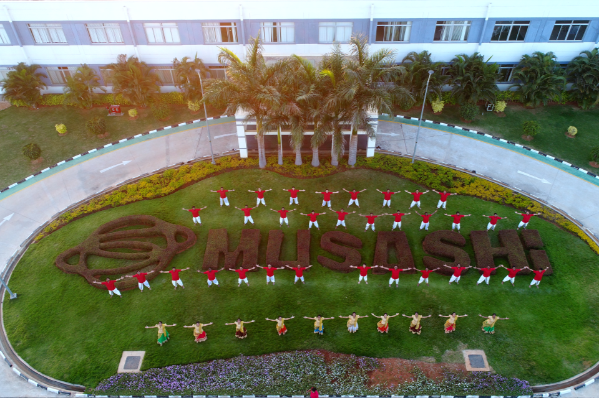
MUSASHI AUTO PARTS INDIA PVT LIMITED
BANGALORE PLANT
HORIZON
WELCOMES
YOU ALL to NHC-2018
No Limitations For Improvements……….

Slide 2
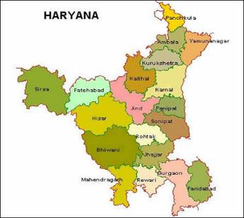
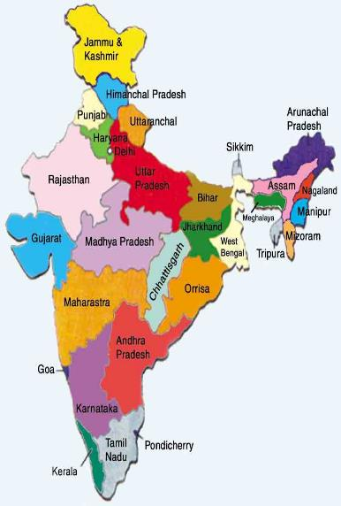

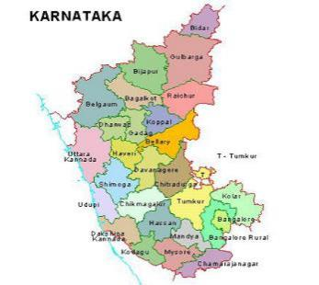
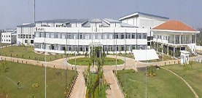
LOCATIONS of map-id
HARYANA
BAWAL
BAWAL
BANGALORE
KARNATAKA
BANGALORE
INDIA

Slide 3
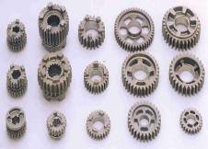

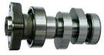
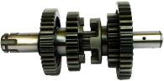
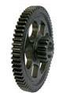
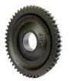
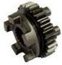
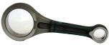
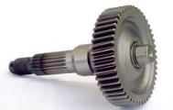
ABOUT OUR PLANT
OUR MAJOR CUSTOMERS ARE HONDA, EXEDY AND TVS.
WE MANUFACTURING :
TRANSMISSION SHAFT,
TRANSMISSION GEAR,
CON ROD & CAM SHAFT

Slide 4
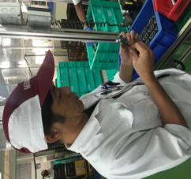
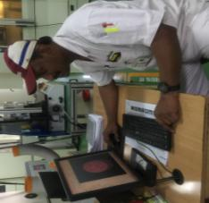

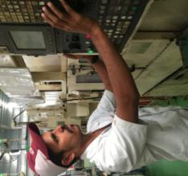
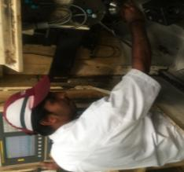
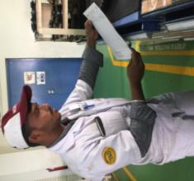
TEAM INRTRODUCTION
ADVISOR
LEADER
KOHJI SAN
STRENGTH: GIVING IDEAS
SAJIN
STRENGTH: MACHINING
PRAVEEN SAN
STRENGTH: PROGRAMMING
MANOHAR SAN
STRENGTH: PART SETTING
PRAMOD SAJN
STRENGTH: TOOLING
BHASKAR SAN
STRENGTH: INFORMATION TOWER

Slide 5


Selection of the CIRCLE THEME

Slide 6

Selection of the theme
 | SERIOUSNESS OF THE NEED FOR AN IMPROVEMENT |  |  | CIRCLE CAPABABILITY |  |  | APPLICATION OF QC TOOLS | TOTAL EVALUATION POINTS | GRAPH OF EVALUATION POINTS
 | DEGREE OF IMPORTANCE | URGENCY | ECONOMC FACTOR | CAN EVERY ONE PARTICIPATE | CAN CIRCLE SOLVE PROBLEM BY THEMSELVES | CAN FINISH WITH IN THE TARGET TIME
REWORK | ◎ |  |  | ◎ | ◎ | ◎ | ◎ | 31
REJECTION | ◎ | ◎ |  |  | ◎ | ◎ |  | 27
PRODUCTIVITY | ◎ | ◎ |  |  |  |  |  | 17
◎
5 POINTS
EVALUATION CRITERIA
3 POINTS
1 POINT
BASED ON THE ABOVE EVALUATION THEME “REWORK ELIMINATION” IS SELECTED.

Slide 7
REWORK STATUS PARTS WISE
PARETO ANALYSIS OF THE REWORK DONE FOR FORK TIGHT
83.52% PROBLEM FOUND IN THE 1st 3 COMPONENTS, OUT OF THIS M3 IS HAVING THE
HEIGHTEST REWORK QUANTITY. SO WE SELECTED M-3 TO DO THE IMPROVEMENT

Slide 8
REWORK STATUS PROBLEM WISE
WE HAVE COLLECTED THE DATA FOR REWORK IN GEAR M3 & FOUND THE ABOVE REASONS FOR THE REWORK .
THE MAJOR REWORK IS DONE DUE TO FORK TIGHT WITH 10% REJ. APPROX.

Slide 9

theme
THEME
ACHIEVING A REDUCTION IN THE FORK TIGHT DEFECT IN ASSEMBLY
TARGET
REDUCING THE FORK TIGHT PART MOVING TO ASSEMBLY TO ZERO.

Slide 10
REWORK ELIMINATION ACTIVITY PLANNING
MIQC NAME: THE TEAM HORIZON
FACILITATER;- KOHJI SAN
1.SAJIN SAN
2.PRAVEEN SAN
3.MANOHAR SAN
4. PRAMOD SAN
5. BHASKAR SAN
PROJECT;- FORK TIGHT REWORK ELIMINATION
START MONTH;- OCT-17
END MONTH;- NOV-17
MEMBERS
Meeting time every Friday 3 to 4 pm
NO OF PROJECTS COMPLETED;-1
ACTIVITY START BY OCT-2017 AND END BY NOV-2017. .

Slide 11
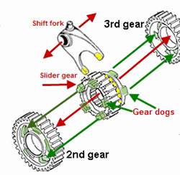
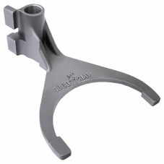
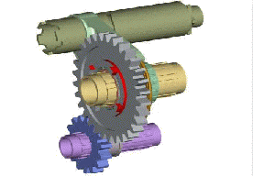
fork in the Motorcycle
WHAT IS THE FORK AND HOW IT WORKS
THE FORK IS USED FOR SHIFTING THE GEARS IN MOTORCYCLE.

Slide 12
Analysis of the Problem

Slide 13
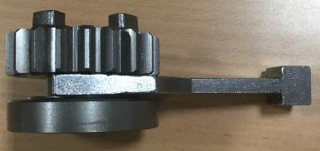
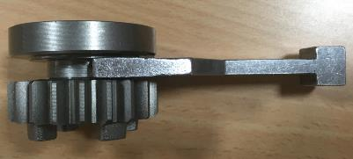
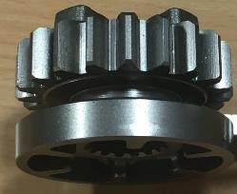
DEFINITION OF THE PROBLEM
WHAT IS FORK TIGHT ?
OK
NG
THE CONDITION IN WHICH THE FORK WILL NOT ENTER IN TO THE GROOVE OF COMPONENT
HOW FORK TIGHT OCCURS ?
IF THE GROOVE WIDTH BECOME UNDER SIZE THAN SPECIFICATION.
IF THE MATERIAL LEFT IN THE CORNERS OF THE GROOVE
IF THE SURFACE ROUGHNESS ON THE GROOVE FACE OUT OF SPEC
GROOVE WIDTH
WHAT PROBLEM OCCURS IF FORK TIGHT MOVE TO CUSTOMER ?
CUSTOMER WILL LOOSE TRUST ON US
ASSEMBLY WILL NOT BE POSSIBLE
CUSTOMER LINE STOP

Slide 14
PROCESS FLOW CHART OF gear m3
Out Sourcing
(SCr420HV 2(ID))
10
80
130
20
90
C05
30
100
140
40
110
50
C02
PARTS FOR ASSEMBLY
C01
C03
60
120
C04
70

Slide 15
BEFORE KAIZEN REWORK DATA
DATA SHOWING THE FORK TIGHT REWORK
AN AVERAGE OF 500 COMPONENTS WERE REWORKED IN EVERY MONTH
267 MINUTES (5HRS) BEING UTILIZED FOR THE REWORK EVERY MONTH
THIS IS AFFECTING THE OEE .

Slide 16
CURRENT SITUATION ANALYSIS
CAUSE
TURNING
BROACHING
SHAPING
HT
PRIORITY
X
7
GROOVE WIDTH UNDER SIZE
X
X
4
GROOVE DIAMETER
OVER SIZE
X
X
6
TOOL WEAR
= 3
= 1
X
= 0
ANALYSIS DONE TO FIND OUT WHICH CAUSES CAN CONTRIBUTE TO THE FORK TIGHT.

Slide 17
ANALYSIS ON CURRENT SITUATION
ANALYSIS DONE ON TURNING-2 TO FIND OUT THE VARIATION IN FORK WIDTH
Inference; we identified 12 causes .

Slide 18

IDEA GENERATION
OFFSET ERROR
HARDNESS VARIATION
INSERT LIFE LESS
TRAINEES
UNSKILLED ASSOCIATE
INSERT TOLERANCE
TOOL HOLDING
Fork tight
COOLANT NOT COMING
INSERT NOT CHANGING AS PER FREQUENCY
PART CLAMPING
DISTORTION NG
AXIS REPEATABILITY ERROR
TOOL LIFE LESS
COOLANT CONDITION
CUTTING PARAMETER
TOOL PATH
BRAIN STORMING WAS DONE TO FIND OUT WAYS TO ELIMINATE THE FORK TIGHT.
Inference; we identified 12 causes .

Slide 19




Sakana no hone (fish bone)
WHY FORK TIGHT HAPPENED
MAN
MACHINE
INSERT NOT CHANGE AS PER FREQUENCY
COOLENT NOT COMING
UN SKILLED ASSOSICIATE
OFFSET ERROR
TOOL HOLDING
AXIS REPEATABILITY ERROR
TRAINEES
PART CLAMPING
CUTTING PARAMETER
No. | SUSPECT
① | DISTORTION IN HT
② | TOOL LIFE
③ | TOOL PATH
④ | TOOL OFFSET
⑤ | INSERT TOLERENCE
TOOL PATH
INPUT STOCK VARIATION
COOLANT CONDITION
TOOL LIFE
DISTORTION IN H/T
INSERT TOLERANCE
HARDNESS VARIATION
METHOD
MATERIAL

Slide 20


Trail Implementation and Checking Performance

Slide 21
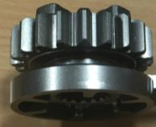
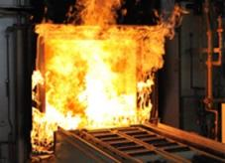
SUSPECT NO-1
No. | SUSPECT
① | DISTORTION IN HT
② | TOOL LIFE
③ | TOOL PATH
④ | TOOL OFFSET
⑤ | INSERT TOLERENCE

Slide 22

HEAT TREATMENT DISTORTION STUDY
ANY DISTORTION IS HAPPENING IN THE GROOVE WIDTH, IN HEAT TREATMENT ?
HOW CAN WE ENSURE THE SAME ?
IF WE CONDUCT THE 9 POINT STUDY ,WE CAN FIND THE DETAILS
SOFT STAGE
5.1
+0.09
+0.05
HARD STAGE
5.1
+0.05
+0.01
Ave = 5.17
Ave = 5.14
STUDY RESULTS FOUND OK
NO PROBLEM FOUND IN HEAT TREATMENT
WHERE IS THE PROBLEM ?

Slide 23
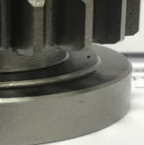
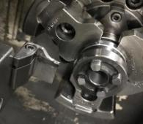
SUSPECT NO-２
No. | SUSPECT
① | DISTORTION IN HT
② | TOOL LIFE
③ | TOOL PATH
④ | TOOL OFFSET
⑤ | INSERT TOLERENCE

Slide 24

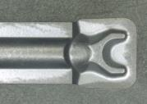
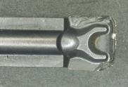
CURRENT CONDITION
IS THE TOOL LIFE COMING AS PER THE STANDARD SET LIFE?
LETS GO AND VERIFY AT GEMBA
CHECKED IN GEMBA FOUND THAT LIFE NOT ACHIEVING AS PER STD
CURRENT INSERT | A4G0405M04U04 GMN
SET LIFE | 500
ACTUAL LIFE | 200
CUTTING SPEED | 160
FEED | 0.2
MAKE | KENNAMETAL
BEFORE
AFTER
INSERT WEAR IS NOT GOOD
WHY TOOL LIFE IS NOT ACHIEVING ?
TOOL LIFE IS NOT ACHIEVED AS PER THE SET LIFE DUE TO MATERIAL CHANGE FROM SCM TO SCR .
WHAT TO BE DONE ? LETS ANALYSIS IN DETAIL.

Slide 25
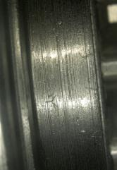
INSERT WEAR CHECK
PRESENT CONDITION
RADIUS FORMED IN THE GROOVE CORNER
GROOVE ROUGHNESS
SPEC: ≤ 12.5
INSERT CORNERS IS CHIPPING OFF & RZ OUT OF SPEC. AFTER 200 NOS
AFTER INSERT WEAR GROOVE WIDTH REDUCES & RADIUS FORMS IN THE CORNERS , AND ALSO FACE ROUGHNESS GETTING INCREASED
Rz 17.37
X
INSERT WEAR IS NOT GOOD.
GROOVE OD BECOMING OVERSIZE (WITH BURR).

Slide 26

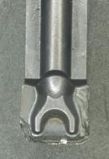
Why-why ANALYSIS
CUTTING PARAMETERS TO BE PUT AS PER LOGICAL CALCULATION
CUTTING PARAMETERS ARE NOT AS PER LOGIC
HOW
CUTTING PARAMETER IS NG
INSERT GET CHIPPED OFF BEFORE REACHING SET LIFE
WHY
WHY
TOOL LIFE NOT ACHIEVING
WHY

Slide 27
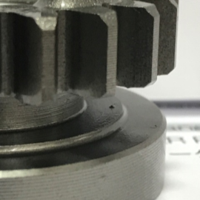
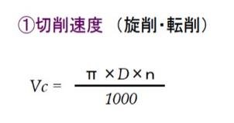
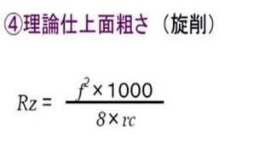
CUTTING PARAMETER CHECK
LOGICAL CALCULATION AS F0LLOWS
X
Cutting speed
Rz max | ≤ 12.5
Cutting speed | Vc 100 ~ 140
Feed | F 0.12
Rough theoretical value
G99G97S2000T303
G96 S160
G0 X46.35
G0 Z-21.15
G1 X22.8 F0.2
G0X35.0
G1 Z-20.03
G1 X22.8 F0.2
TOOL PATH
M-3 cycle time
CUTTING PARAMETER ARE NOT USED AS PER LOGICAL CALCULATION

Slide 28

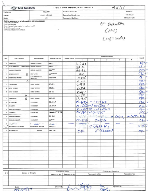
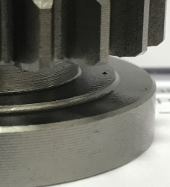
LOGICAL DATA IMPLEMENTATION
BEFORE
AFTER
SETTING APPROVAL
G99G97S2000T303
G96 S160
G00 X46.35
G00 Z-21.15
G01 X22.8 F0.2
G00X35.0
G01 Z-20.03
G01 X22.8 F0.2
G99G97S2000T303
G96 S120
G00 X46.35
G00 Z-21.15
G01 X22.8 F0.12
G00X35.0
G01 Z-20.03
G01 X22.8 F0.12
SPEC: ≤ 12.5
Rz : 4.18
IMPROVEMENT IN TOOL PATH
MATERIAL LEFT-OFF NOT SOLVED
PARAMETERS CHANGED AS PER THE LOGICAL CALCULATION.
SURFACE ROUGHNESS ACHIEVED
WHY BURR NOT REMOVED & TOOL LIFE NOT ACHIEVED ? LETS CHECK FOR ALTERNATIVE GRADES

Slide 29
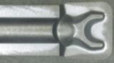
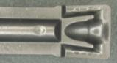
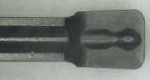
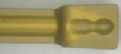
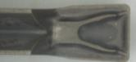
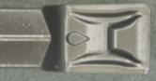
INSERT SELECTION
A4G0405M04U04 GMN
CURRENT CHIP BREAKER
A4G0405M04U04 GUP
DTE400-040 -GROUND
ALTERNATE CHIP BREAKERS
DTE400-040 -MOULDED
GY2M0400G040N-MM
GDM4020N-040 GM
INSERT IS SELECTED BY CONSIDERING THE GEOMETRY , THE CHIP BREAKING ABILITY AND ADVICE FROM THE ADVISOR

Slide 30


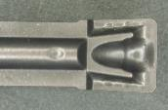
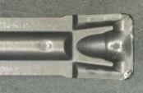
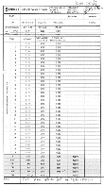
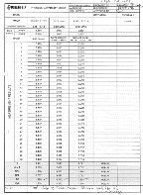

NEW CHIP BREAKER TRIALS
 | BEFORE | AFTER
CURRENT INSERT | A4G0405M04U04 GMN | A4G0405M04U04 GUP
SET LIFE | 500 | 500
ACTUAL LIFE | 350 | 500
CUTTING SPEED | 120 | 120
FEED | 0.12 | 0.12
MAKE | KENNAMETAL | KENNAMETAL
Cp & Cpk
INSERT CORNER WEAR OUT AFTER 500 NOS
BURR IN GROOVE
BEFORE
AFTER
CP1.42 & CPK1.37
TOOL LIFE IMPROVED .
WHY BURR COMING IN BETWEEN THE RUNS ?
IS THE TOOL PATH CORRECT ? . LETS CHECK THE SAME. .

Slide 31
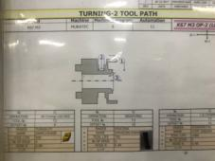
SUSPECT NO-３
No. | SUSPECT
① | DISTORTION IN HT
② | TOOL LIFE
③ | TOOL PATH
④ | TOOL OFFSET
⑤ | INSERT TOLERENCE

Slide 32

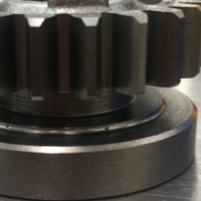

TOOL PATH MODIFICATION
CHECKED THE TOOL PATH , CORRECTION NEEDS TO BE DONE
BEFORE CUTTING CONDITION
AFTER CUTTING CONDITION
G00 Z-21.15
G01 X22.8 F0.12
G00X35.0
G01 Z-20.03
G01 X22.8 F0.12
G01Z-21.15
G01 X35.0F0.12
G00X50.0
RETURN FINISHING CUTTING PATH
G01 X22.8 F0.12
G00X35.0
G01 Z-20.03
G01 X22.8 F0.12
G01Z-21.15
G00X35.O W0.3F0.12
G01 Z-21.15
G01 X22.8 F0.12
FORWARD FINISHING CUTTING PATH
TOOL PATH MODIFIED & OBSERVED FOR A WEEK .
FORK TIGHT COMPONANT AGAIN COMING
WHY FORK TIGHT COMING ? LETS ANALYSIS. .

Slide 33
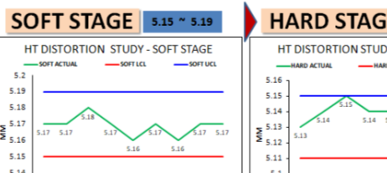


REASONING
TOOL LIFE ACHIEVED
DISTORTION OK
BUT FORK TIGHT ISSUE WAS NOT SOLVED
GROOVE WIDTH O/S PARTS FOUND
THEN WHO IS THE CULPRIT?
IS IT OFFSET ERROR?
IS IT THE INSERT TOLERENCE ?
LETS ANALYSE ONE BY ONE……………………….
CP & CPK OK

Slide 34
SUSPECT NO-４
No. | SUSPECT
① | DISTORTION IN HT
② | TOOL LIFE
③ | TOOL PATH
④ | TOOL OFFSET
⑤ | INSERT TOLERENCE

Slide 35
TOOL OFFSET CHANGE
TOOL OFFSET WILL BE ONE OF THE REASON FOR GROOVE WIDTH O/S
LETS ANALYSE THE CURRENT OFFSET CONDITION & WILL CORRECT THE ISSUE
BEFORE
AFTER
TO3
T13
G99G97S2000T303
G0X46.35
Z-21.15
G1X22.85F0.12
T13
G0X35.0
G1Z-20.11
G1X22.8F0.12
G99G97S2000T303
G0X46.35
Z-21.15
G1X22.85F0.12
GOX35.0
G1Z-20.03
G1X22.8
G04X05
2 OFFSET FOR GROOVE WIDTH CORRECTION
TOOL OFFSET CHANGED FROM `DOUBLE OFFSET TO SINGLE OFFSET.
PROGRAM CORRECTED
WHY STILL FORK TIGHT IS COMING. ? LETS CHECK OTHER SUSPECTS. .

Slide 36


SUSPECT NO-５
No. | SUSPECT
① | DISTORTION IN HT
② | TOOL LIFE
③ | TOOL PATH
④ | TOOL OFFSET
⑤ | INSERT TOLERENCE

Slide 37



REASONING
DISTORTION OK
TOOL LIFE ACHIEVED
CP & CPK OK
OFFSET CORRECTED
THEN WHY IS THE FORK TIGHT COMING AGAIN ?
IS THERE ANY VARIATION IN INSERT TO INSERT ?
LETS CHECK THE SAME……………………….

Slide 38


INSERT ANALYSIS
CHECKED THE INSERTS FOUND VARIATION IN DIFFERENT BATCHES
LETS PRODUCE THE PARTS ACCORDING TO BATCHWISE INSERT…
BATCH NO: 3774691 |  | BATCH NO:3791293 |  | BATCH NO:4086935
SL NO | INSERT SPEC | SL NO | INSERT SPEC | SL NO | INSERT SPEC
1 | 4.085 | 1 | 4.124 | 1 | 3.985
2 | 4.083 | 2 | 4.126 | 2 | 3.986
3 | 4.084 | 3 | 4.125 | 3 | 3.986
4 | 4.085 | 4 | 4.126 | 4 | 3.984
5 | 4.085 | 5 | 4.127 | 5 | 3.985
6 | 4.086 | 6 | 4.124 | 6 | 3.985
7 | 4.084 | 7 | 4.124 | 7 | 3.984
8 | 4.086 | 8 | 4.125 | 8 | 3.985
9 | 4.085 | 9 | 4.124 | 9 | 3.986
10 | 4.084 | 10 | 4.125 | 10 | 3.984
5.17
5.20
X
X
5.07
THE MAX VARIATION COMING IS 0.143 MM
WHY VARIATION COMING IN DIFFERENT BATCHES ?. .

Slide 39



INSERT DETAIL
WE NEED TO CHECK THE CURRENT INSERT TOLERENCE
X
Comp spec
INSERT MANUFACTURING TOLERENCE FOUND MORE THAN THE PART SPEC.
WE NEED AN INSERT HAVING TOLERANCE EQUVALENT TO PART SPEC

Slide 40

INSERT TRIAL 1
X
WE NEED THE PRECISSION GRIND INSERT HAVING ±0.020 TOLERENCE FOR THIS APPLICATION
 | BEFORE | AFTER
CURRENT INSERT | A4G0405M04U04 GUP | DTE400 – 040 T9125
TOLERANCE | ± 0.08 | ± 0.020
SET LIFE | 500 | 500
ACTUAL LIFE | 500 | 20 / 30
CUTTING SPEED | 120 | 120
FEED | 0.12 | 0.12
MAKE | KENNAMETAL | TUNGALOY
DTE400-040 –GROUND
TOLERANCE ±0.02
TAKEN TRIALS WITH THE GROUND INSERT – LIFE NOT ACHIEVED .
PRECISION GRIND INSERT WILL NOT IMPROVE THE LIFE SHOULD GO FOR MOULDED INSERT

Slide 41

INSERT SELECTION
CHECKED FOR THE MOULDED INSERT WITH LEAST TOLERANCE
SELECTED GDM4020N-040 GM HAVING TOLERANCE OF ± 0.03 MM
BATCH NO: R0529E4 |  | BATCH NO:R1033EZ |  | BATCH NO: N113905
SL NO | INSERT SPEC | SL NO | INSERT SPEC | SL NO | INSERT SPEC
1 | 3.971 | 1 | 3.970 | 1 | 3.975
2 | 3.975 | 2 | 3.967 | 2 | 3.975
3 | 3.973 | 3 | 3.970 | 3 | 3.970
4 | 3.971 | 4 | 3.974 | 4 | 3.971
5 | 3.974 | 5 | 3.973 | 5 | 3.968
6 | 3.969 | 6 | 3.972 | 6 | 3.973
7 | 3.971 | 7 | 3.973 | 7 | 3.974
8 | 3.975 | 8 | 3.969 | 8 | 3.970
9 | 3.973 | 9 | 3.967 | 9 | 3.968
10 | 3.971 | 10 | 3.967 | 10 | 3.975
GDM4020N-040 GM
TOLERANCE ±0.03
ARRANGED 3 BATCH INSERT FOR THE WIDTH VERIFICATION .
THE MAXIMUM VARRAITION COMING IS 0.008 MM
DECIDED TO GO WITH THIS INSERT FOR FURTHER TRIALS .

Slide 42





INSERT TRIAL 2
 | BEFORE | AFTER
CURRENT INSERT | A4G0405M04U04 GUP | GDM 4020N -040GM
TOLERANCE | ± 0.08 | ± 0.03
SET LIFE | 500 | 500
ACTUAL LIFE | 500 | 700
CUTTING SPEED | 120 | 130
FEED | 0.12 | 0.15
MAKE | KENNAMETAL | KYOCERA
SPEC: ≤ 12.5
Rz 11.45
Cp & Cpk
BEFORE
AFTER
INSERT WEAR FOUND OK
CP1.44 & CPK1.38
TRIAL SUCCESSFUL AND TOOL LIFE SET TO 700 NOS.
FORK TIGHT REWORK REDUCED . .

Slide 43
Activity schedule plan
MIQC NAME: THE TEAM HORIZON
DEPT; KAIZEN TEAM
FACILITATER;- KOHJI SAN
1.SAJIN SAN
2.PRAVEEN SAN
3.MANOHAR SAN
4. PRAMOD SAN
5. DARSHAN SAN
PROJECT;- FORK TIGHT REWORK ELIMINATION
START MONTH;- OCT
END MONTH;- NOV
MEMBERS
Meeting time every Friday 3 to 4 pm
NO OF PROJECTS COMPLETED;-1
WE COMPLETED OUR ACTIVITY AS PER THE PLAN

Slide 44
EFFECT CONFIRMATION

Slide 45

Effect confirmation
ACHIEVEMENT 99.4%
REWORK REDUCTION
AFTER IMPLEMENTATION FORK TIGHT QUANTITY IS REDUCED

Slide 46
HORIZONTAL DEPLOYMENT
HORIZONTAL DIPLOYMENT COMPLETED IN C-4 KTE/K67, C-3 K55 & M-4 K55 LINE

Slide 47
Tangible benefits
TOOL LIFE UP
REWORK TIME REDUCED

Slide 48
intangible benefits
TEAM SKILL LEVEL
Before Project
After project

Slide 49





QC TOOLS & TECHNICS USED
We used following QC tools & Techniques to our project
Brain storming
Cause and Effect Diagram
Process Flow Diagram
Why-why analysis
Pareto Diagram

Slide 50
LEARNINGS FROM OUR PROJECT
INSERT SELECTION
PROBLEM ANALYSIS
OPTIMISATION OF CUTTING PARAMETERS
USAGE OF QC TOOLS

Slide 51

ANY SUGGESTION PLEASE
THANK YOU

